Slide 1





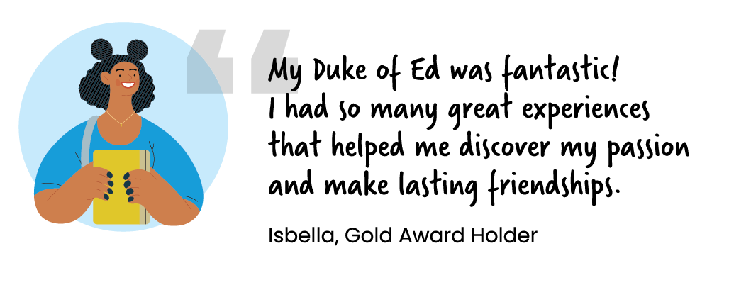
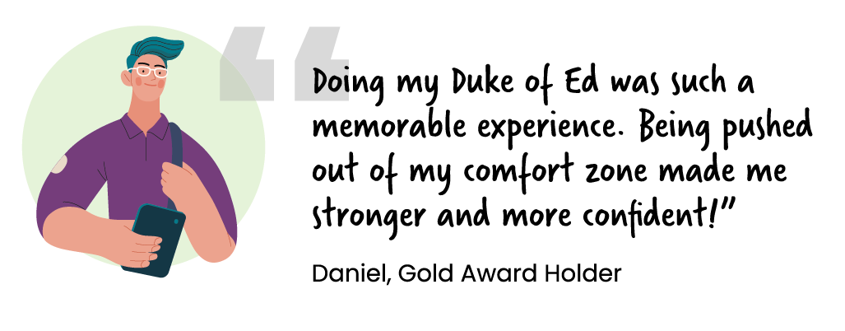
THE DUKE OF EDINBURGH’S HILLARY AWARD:
GET INVOLVED
The Award is an opportunity to challenge yourself, learn new skills, and make a real impact. Whether it’s, giving back to your community, learning new skills or pushing your limits, the Duke of Edinburgh’s Award helps you step up and stand out.
STEP OUT AND EXPLORE
BE RECOGNISED
Explore your environment, grow your confidence and discover new things about yourself, as you step out of your comfort zone.
Duke of Ed is recognised by employers and universities the world over. Having it on your CV will help you stand out.
MAKE A DIFFERENCE
DEVELOP
AND GROW
Volunteering will make
a difference to your community and to the people around you. Plus you’ll feel great doing it.
Whether it’s trying something new or mastering an existing skill, what you learn on your Duke of Ed will be with you for life!
IMPROVE YOUR WELLBEING
Through adventure, service, and skill-building, develop mental strength, social connections, and a positive mindset - all while having fun, making great friends and pushing your limits!

Slide 2
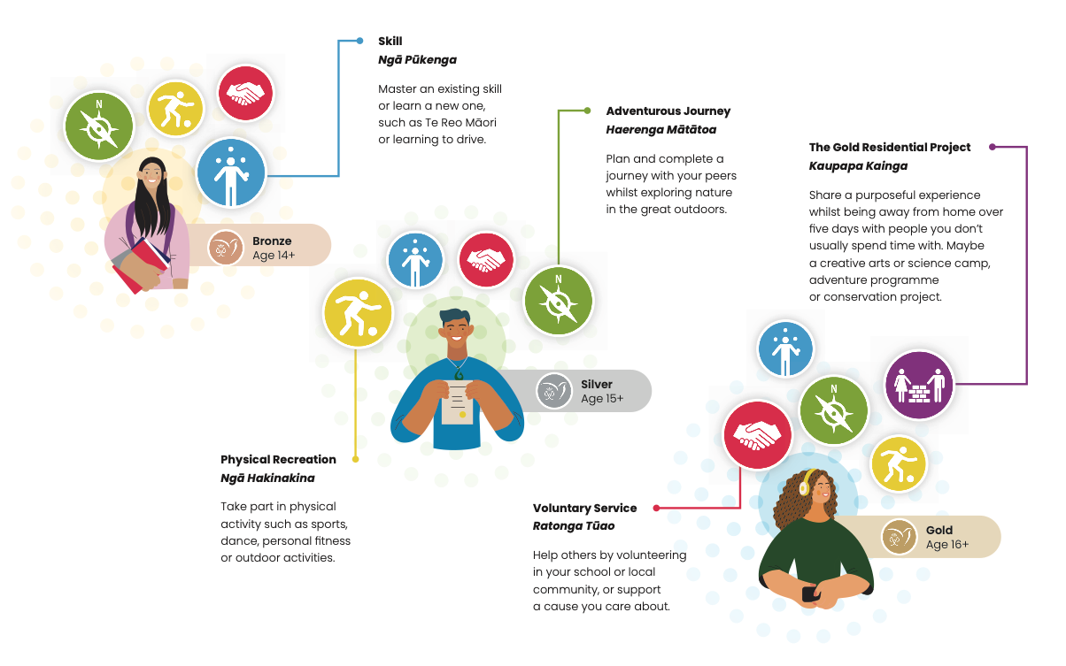
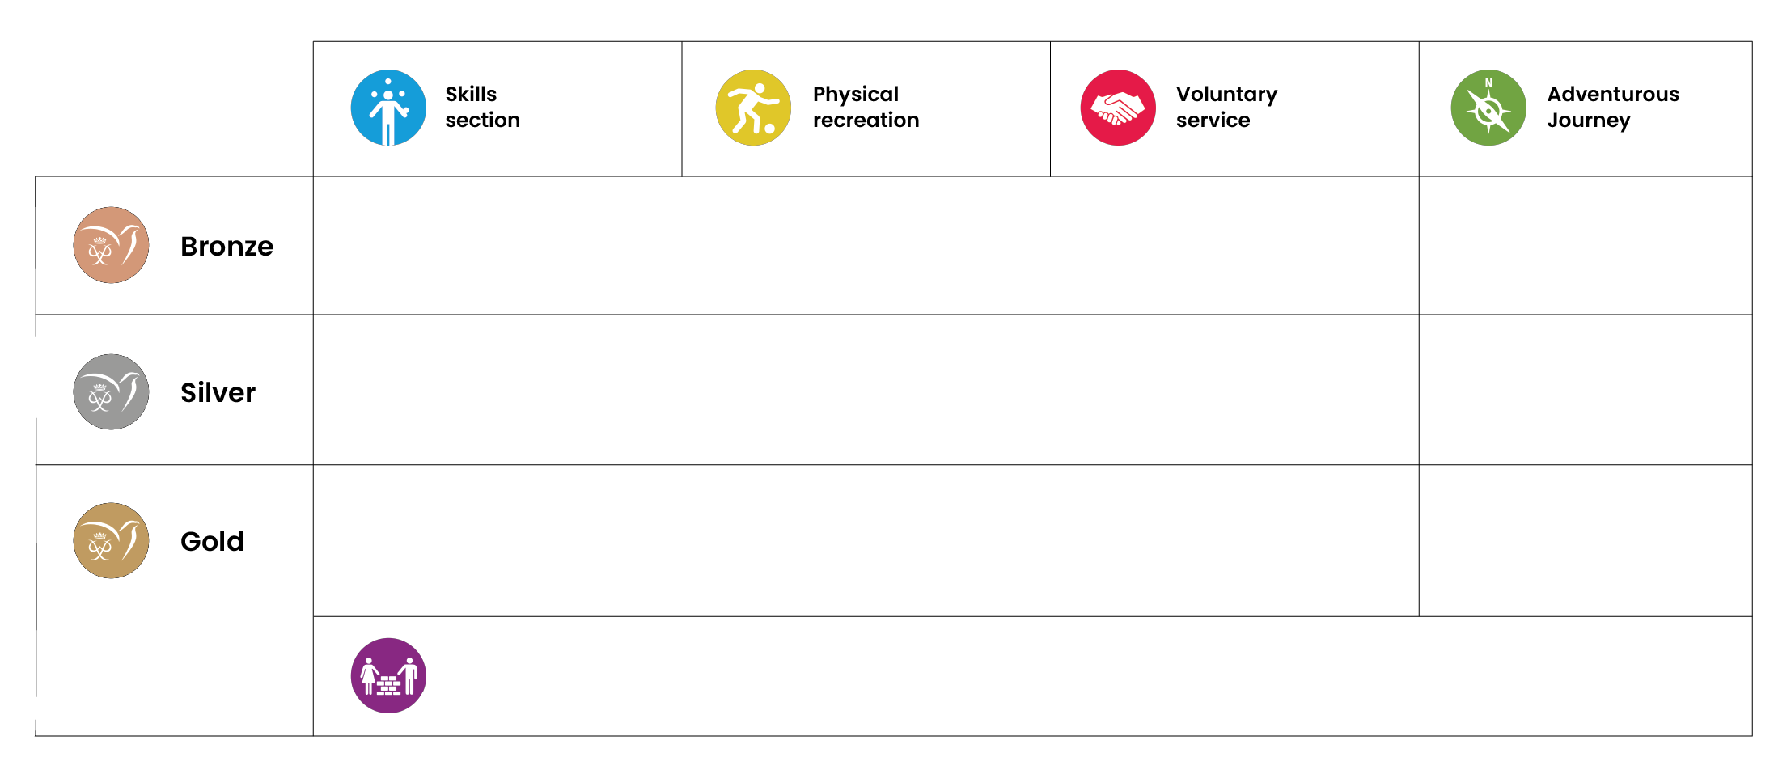
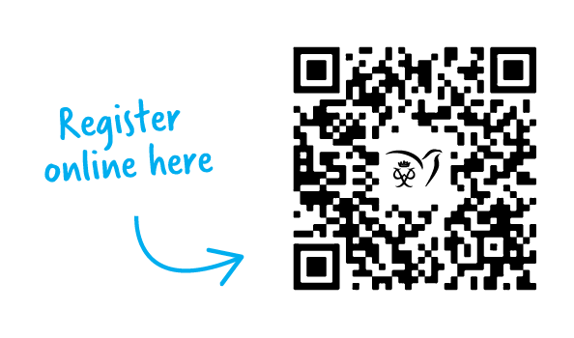
YOUR DUKE OF ED
There are 3 Award levels:
• Bronze: start in the year you turn 14
• Silver: Start when you finish Bronze or from age 15
• Gold: Start when you finish Silver or from age 16
At each Award Level you complete 4 Award sections with a 5th section at Gold.
Be active for 13 hours over 13+ weeks in 2 sections and 26 hours over 26+ weeks for 1 section
2 Journeys
Be active for 26 hours over 26+ weeks in each section
If you have not completed your Bronze Award then complete an additional 26 hours in 1 of these Sections
2 Journeys
Be active for 52 hours over 52+ weeks in each section
If you have not completed your Silver Award then complete an additional 26 hours in 1 of these Sections
2 Journeys
Complete 5 days and 4 nights doing the Gold Residential Project
Get started:
Kōrero with your Award Leader to find out how to register.

